Slide 1
Unsupervised ASR
Project Advisor: Dr. Stas Tiomkin
Team Members: Akhil Reddy Dooliganti
Sudheer Tati
Naga Venkata Sai Sathwik Edupuganti
Srikara Mohana Sai Sachin Nekkanti

Slide 2
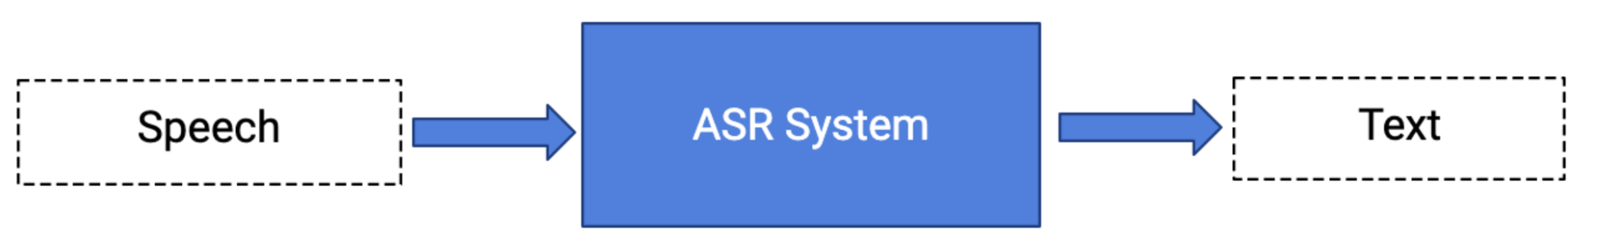
Automatic Speech Recognition(ASR)
What is ASR?
Converting Audio signals -> Text
[without any human intervention]
Why is ASR important?
Enables the humans to interact with the machines
Social contribution - contribute to low resource languages, helping people with disabilities.

Slide 3
Earlier Approaches
Supervised approach
Requires labeled data
Self-supervised approach
Requires less amount of labeled data.
Unsupervised Automatic Speech Recognition
Requires no labeled data
Prominence of Unsupervised ASR and Why it is important?
Tackles problems that humans might find insurmountable either due to a limited capacity.

Slide 4
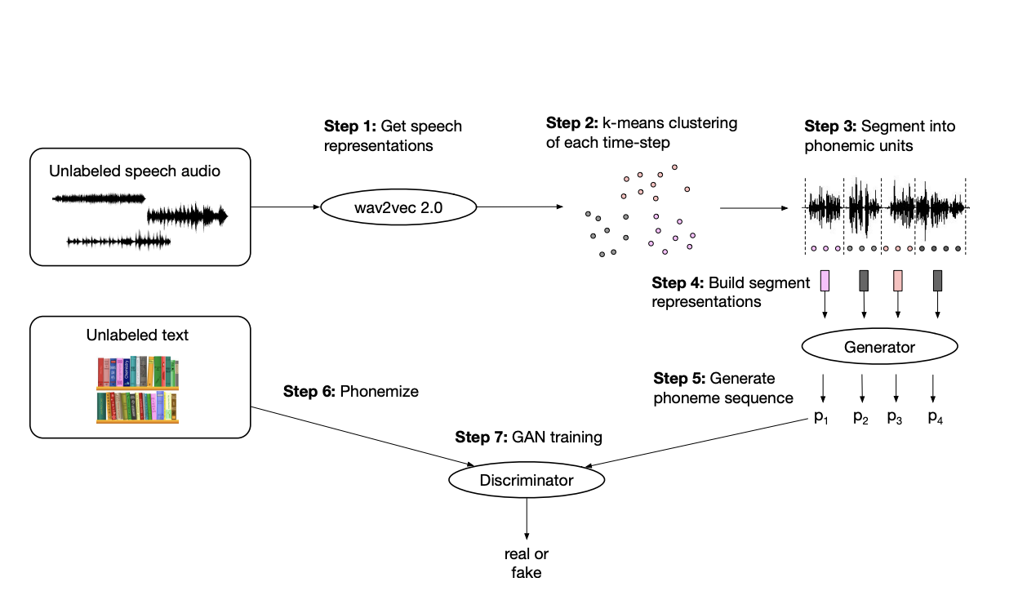
ASR-U Architecture utilized in the current project

Slide 5
Main components of Unsupervised ASR
GAN, generative adversarial network
Contrastive representation learning of speech features (wav2vec)
Control of the diversity of generated phoneme sequences

Slide 6
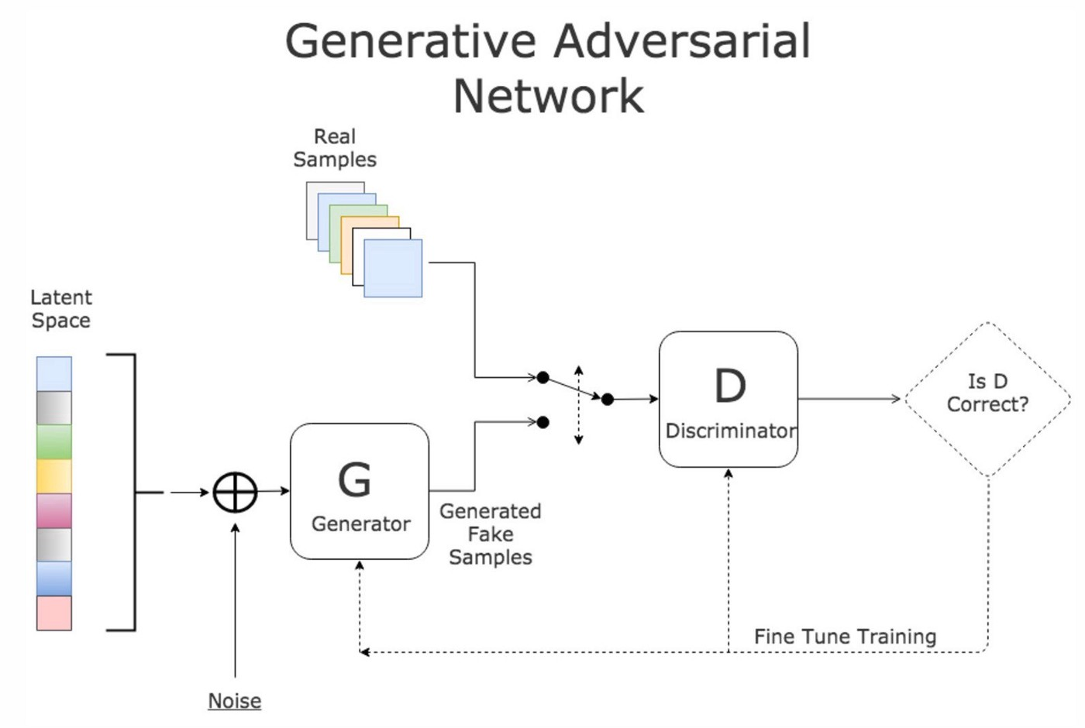
GAN - Generative Adversarial Network
GANs are an approach to generative modeling using deep learning methods, such as convolutional neural networks.
GAN Components:
Generator - Takes segment representations as input and outputs the probability distribution of the phoneme sequences.
Discriminator - Phonemized unlabeled text data is taken and passed to the discriminator to classify whether the phonemes are from actual distribution or not.
Notes:
GANs belong to the set of algorithms named Generative models, which uses unsupervised approach to learn patterns from real data and then to generate fake data as similar as possible to the fake data. Generating realistic samples of (video/image/audio), Image-to-Image Translation,Text-to-Image Translation, you can also use this to augment your dataset are few of multiple use cases of GAN.
GAN is composed of two sub models- the generator and the discriminator. Generator’s job is to create fake samples to fool the generator. The discriminator’s job is to take a given sample and figure out if it is a fake sample or if it is a real sample and not get fooled by the generator. They both compete to win and they both develop as we keep training these two algorithms. Eventually there comes a point where generator is good at generating fake samples that look realistic enough where the discriminator cannot be able to tell the difference between the real and fake ones.

Slide 7
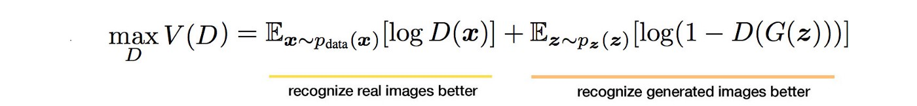
Discriminator Loss
We train D to maximize the probability of assigning the correct label to both training examples and samples from G
Z: Noise vector (Dimension of the noise vector is a hyperparameter).
G(Z): Output of the generator when given the noise vector Z.
X: Real Training data.
D(G(Z)): Output of the discriminator when given fake generated data or G(Z).
D(X): Output of the discriminator when given real training data from X.
Notes:
Lets take a look at the objective function of discriminator-there are two components in this, in the first term we are looking at instances taken from the real data distribution. In the second part Expectation from z indicates, we are taking instances from the noisy distribution. The x in the first term are real values and we want discriminator to give the output i.e D(x) as 1. If we look at the second term, we want the discriminator to be able to tell that they are fake. We want the output here to be 0. Therefore we will get the maximum value of the function when log d(x)=1 and D(G(z))=0.

Slide 8
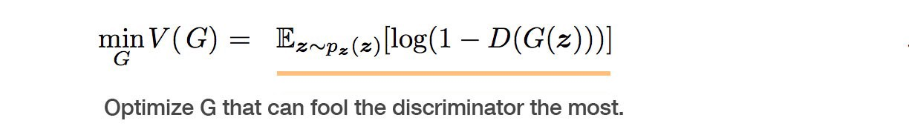
Generator loss
We simultaneously train G to minimize log(1 − D(G(z))):
Notes:
Regarding the generator, we want to minimize the objective function. We are looking at fake instances generated by G using the latent space. We want discriminator to output 1 so that it will get fooled. Thats why we want to minimize this function regarding the generator.

Slide 9
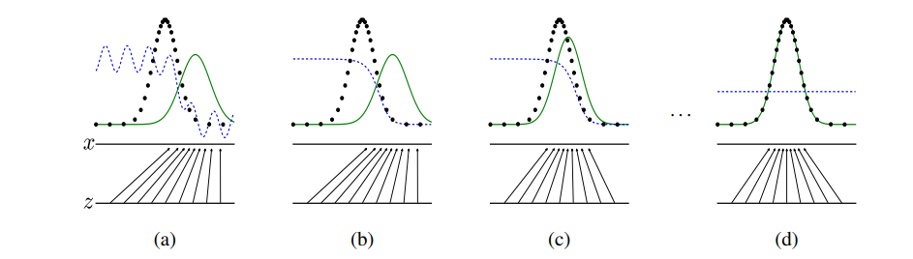
Combined Loss Function
The Generator and Discriminator will play a minimax game in which G wants to minimize the loss function (V) while D wants to maximize it
Notes:
Combining the both objective function, we get the min max loss function. We ant to maximize it for the D and minimize it for the generator.
Black Dotted line- is the original data i.e the probability density function of the original dataset
Green solid line-is the probability density function of the generator
Blue dotted line is the discriminator distribution.
In the first step you can see that original data distribution and the generator data distribution are far away so that discriminator function can be able to roughly distinguish between them. As we move in iterations further, our discriminator function becomes more and more better because we update the discriminator using gradient descent. Now D is able to distinguish these two datas much better than the previous step. In the third step, we have updated the generator distribution therefore the green curve is trying to merge with the dotted line. The discriminator is having hard time to tell the difference between these two distributions. After multiple iterations, both the distributions overlap each other and the discriminator gives the output as 0.5 as it is not able to tell the difference between the real and fake samples.

Slide 10
Representation learning by Wav2Vec 2.0
Wav2vec 2.0 gives powerful representations of speech and use these speech representations to fine-tune the models for downstream tasks such as speech recognition, speech emotion classification, etc.,
Wav2Vec 2.0 masks the speech input in latent space and predict the masked representations using contrastive task from latent and quantization representations.
Using the Wav2Vec 2.0 speech representations for downstream tasks, models achieved better accuracy with less amount.

Slide 11
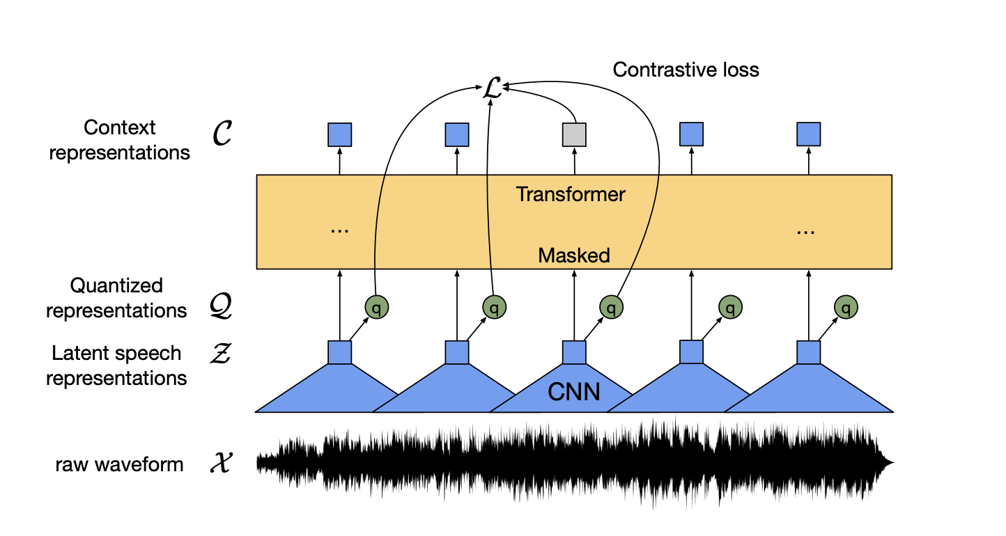
Wav2vec Model Architecture:
Components:
Feature Encoder
Context representations using transformers
Quantization module.

Slide 12
Feature Encoder (X -> Z):
Feature encoder takes the input as raw audio files(X) and outputs the latent speech representations z1,........zT for T time-steps.
Feature encoder consists of several blocks of temporal convolution with a GELU activation.
Layer normalization will be applied to the output channels of this network.
The raw waveform input to the first layer of encoder and it is normalized to zero mean and unit variance.

Slide 13
Context representations using transformers (Z -> C)
The output of the feature encoder are fed into the context network network(Transformer Network).
In transformer network, instead of fixed positional encoding it is replaced with relative positional encoding.

Slide 14
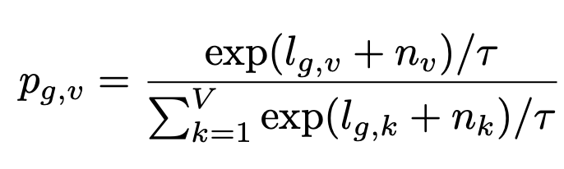
Quantization Module (Z->Q):
The output of the feature encoder Z is discretize to finite of speech representations q1,.....qT for T Time-steps via product Quantization.
Product Quantization is a technique to choose quantized representations from multiple codebooks and concatenating them.
Given G codebooks with V entries e ∈ R V ×d/G and we choose one entry from codebook and concatenate them and apply linear transformation.
By using Gumbel softmax choose one entry from each codebooks. This enables the fully differentiable way of discrete entry.
Feature encoder Z is mapped to l ∈ R G×V logits and the probabilities for choosing the v-th codebook entry for group g are
τ is a non-negative temperature.
n = − log(− log(u)), u = U(0, 1).

Slide 15
Training
Masking
Objective
contrastive loss
Diversity Loss and Penalty

Slide 16
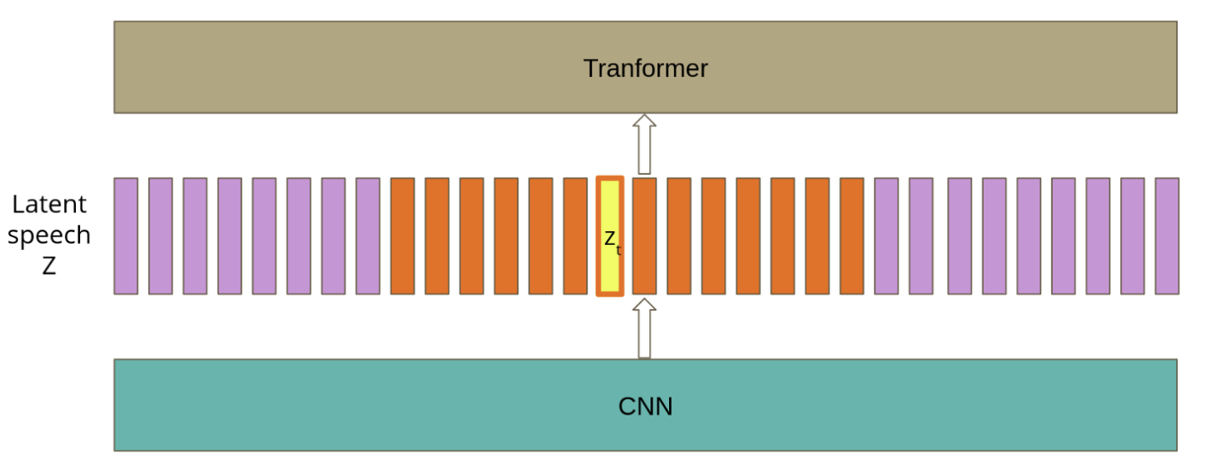
Masking:
Mask the proportion the output of the feature encoder before feeding into Context Network(Transformer Network) with a trained feature vector shared between all masked time steps.
Randomly sample from the latent speech Representations without replacement p = 0.65 of all time steps to be a starting index and then mask subsequent M= 10 time steps.

Slide 17

Training Objective:
Training Objective is to learn the speech representation by solving a contrastive task (Lm) which required to predict the true latent speech representation for masked time steps.
It is solved by using combination of contrastive loss(Lm) and diversity loss(Ld).
α = tuned hyperparameter

Slide 18
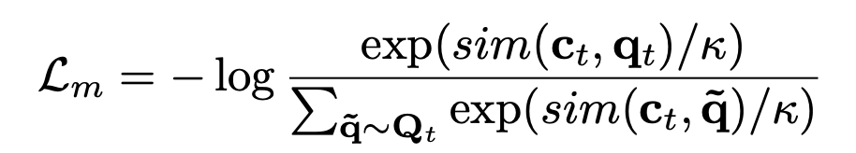

Contrastive Loss(Lm)
Given context network output ct centered over masked time step t, the model needs to identify the true quantized latent speech representation qt in a set of K + 1 quantized candidate representations ˜q ∈ Qt which includes qt and K distractors. Distractors are uniformly sampled from other masked time steps of the same utterance. The loss is defined as
where

Slide 19
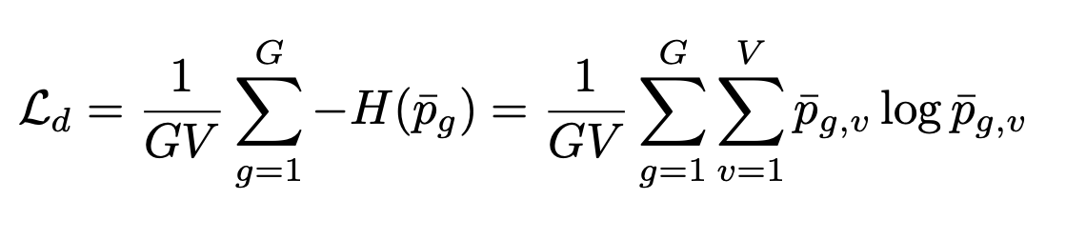
Diversity Loss and Penalty:
Diversity loss helps us equal use of V entries from G codebooks by maximizing the entropy of the average softmax distribution L.
To stabilize the training, we found applying L2 penalty on the last layer of the feature encoder but before layer normalization.
While calculating loss they didn’t include Gumbel noise and temperature in the softmax distribution

Slide 20
Project - Unsupervised ASR
Goal: In this project we try build an Automatic speech recognition application using Unsupervised approach for low resource language.
https://arxiv.org/pdf/2105.11084.pdf
Recent advancements in the speech recognition domain was a collaborative effort by Meta AI and Google AI which are aiding us to build ASR-U.
The Current State of the art approach proposes a new architecture
Components
Generative Adversarial Networks (GAN’s)
wav2Vec2.0

Slide 21
The full scheme of ASR-U Architecture
Notes:
The goal is to map an audio signal correctly to a phoeme , so in a wav2vec transfomer has 24 blocks

Slide 22
Preprocessing
Speech
Silence Removal
Silence token insertion: Used unsupervised model to label some segments with a Phonemic silence token (SIL; § 4.1)
Text
Phonemization - Converts a sequence of words into a sequence of phonemes
Silence token insertion: Added to unlabeled text to better resemble the speech audio which does contain silences
SIL token is added to the beginning and the end of all phonemized unlabeled text sentences

Slide 23
Objective
It is similar to the GAN’s loss function but with extra three regularizers added to it
Gradient penalty - Smoothens the training of GAN
Segment smoothness penalty - Penalty to make sure the consecutive frames are similar
Phoneme Diversity Loss - Penalty for coverage of all the phonemes to maintain diversity, entropy is calculated to determine the penalty

Slide 24
Loss Functions
Gradient penalty:
To stabilize training, we penalize the gradient norm of the discriminator with respect to the input
Segment smoothness penalty:
The k-means segmentation of the speech audio is more granular than a typical phonemic transcription
Neighboring representations are highly correlated.
Added a penalty which encourages the generator to produce similar outputs for adjacent segments
Phoneme diversity loss:
Penalize low usage of the phoneme vocabulary by the generator network on the batch level.
In particular, we maximize the entropy of the averaged softmax distribution of the generator over the phoneme vocabulary across a batch B of utterances
Notes:
Segment smoothness- it is a penalty which encourages the generator to produce similar outputs for adjacent segments.
Diversity loss - if use only a particular set of phonemes it may increase bias so in order to increase the inclusiveness of all phonemes they have used diversity loss to use all the phonemes.

Slide 25
Resources
NVIDIA V100 GPU instance
UASpeech Dataset
TORGO Dataset
Unlabelled Raw Audio files of Dysarthric speakers

Slide 26
Unsupervised cross validation metric
Metrics
LM negative log-likelihood (NLL) - Indicator of fluency for a given transcription and it is measured with a language model pLM trained on phonemized text data
Vocabulary usage - It is the proportion of the phoneme vocabulary being output by the model via Viterbi decoding.
Measuring vocabulary usage identifies degenerate models which output fluent but trivial transcriptions.

Slide 27
THANK YOU!

